Slide 1
Real Time Mapping Of Epidemic Spread

Slide 2
INDEX
Abstract
Objective of project
Problem Statement
Scope & Motivation
Introduction
Literature survey
Existing Method
Disadvantages
Proposed method
Advantages
Project Flow
Hardware and Software Requirements
Architecture
Modules
UML Diagram
Output Screens
Conclusion
Future Work
References

Slide 3
ABSTRACT
This integrated healthcare platform offers a robust system for doctors and patients. Doctors can efficiently manage appointments, accepting or rejecting them, and input epidemic-related data. Patients can register, book appointments, track their status, and update their recovery status. The dashboard provides a comprehensive overview of epidemic disease details, allowing day and month-wise filtering. Users can download patient details and access graphical representations of epidemic cases and recovery rates for informed decision-making. This streamlined approach combines mathematical modeling and machine learning with practical healthcare management, fostering a proactive and data-driven response to epidemics.
Keywords: Healthcare Modules, Admin, Doctor epidemic disease.

Slide 4
OBJECTIVE OF PROJECT
The objective is to create an integrated healthcare platform that optimizes pandemic response. Incorporating mathematical modeling and machine learning, the system empowers doctors to efficiently manage appointments and input epidemic-related data. Patients can easily register, book appointments, track statuses, and update their recovery status. The dashboard offers a comprehensive view of epidemic details with day and month-wise filtering, accompanied by downloadable patient information and graphical representations for informed decision-making. This platform aims to streamline healthcare management, fostering a proactive, data-driven approach to epidemic control and patient care.

Slide 5
PROBLEM STATEMENT
The current healthcare decision-making landscape faces challenges in effectively responding to epidemics, such as COVID-19. Existing studies lack generalization or surveillance data, leading to suboptimal policy decisions. City administrators rely on open-loop, belief-based decision-making, hindering timely policy enforcement. To address these issues, there's a need for an integrated healthcare platform. The proposed platform aims to merge mathematical modeling and machine learning for accurate epidemic predictions, providing doctors with tools for efficient appointment management and real-time epidemic data input. Patients can seamlessly navigate the system, booking appointments and monitoring their recovery status. The overarching problem is the lack of a comprehensive, data-driven approach to epidemic control and patient care.

Slide 6
SCOPE AND MOTIVATION
MOTIVATION:
This integrated healthcare platform addresses critical gaps in epidemic management by seamlessly merging mathematical modeling, machine learning, and practical healthcare functionalities. Offering doctors streamlined appointment management and real-time epidemic data input, it empowers patients to actively engage in their healthcare journey. The comprehensive dashboard ensures informed decision-making with day and month-wise epidemic insights. Despite potential challenges, the platform's data-driven approach optimizes pandemic response, fostering a resilient and adaptive healthcare system for enhanced epidemic control and patient care.

Slide 7
SCOPE AND MOTIVATION
SCOPE:
The scope of this integrated healthcare platform encompasses the efficient management of epidemic scenarios, merging mathematical modeling, machine learning, and practical healthcare functionalities. The platform facilitates doctors in optimizing appointment schedules and entering epidemic-related data, ensuring timely and data-driven decision-making. Patients can seamlessly register, book appointments, and monitor their recovery progress. The comprehensive dashboard extends the scope to include detailed day and month-wise epidemic insights, downloadable patient data, and graphical representations for informed analysis. This system's overarching scope is to enhance pandemic response, offering a holistic approach that amalgamates technological advancements with real-world healthcare management.

Slide 8
INTRODUCTION
The COVID Symptom Study app, released on March 24, 2020, collects daily updates on self-reported COVID-19 symptoms and users' residential postcodes. The Secure Anonymised Information Linkage (SAIL) Databank securely stores and uses anonymized person-based data for health research. During the pandemic, SAIL received daily updates from the COVID Symptom Study app, enabling near real-time health surveillance across the UK.
To understand the localized spread of the disease, existing statistical methodology was adapted for the analysis of geo-referenced health outcome data. This allowed mapping, at a fine resolution (Lower-layer Super Output Area or equivalent), the prevalence of positive symptom reports among app users over a rolling 14-day period. These maps, despite the limitations of self-reported data, offered the first fine-scale, UK-wide assessment of the geographical distribution of probable COVID-19 infections. They have been utilized by devolved administrations for pandemic planning.

Slide 9
LITERATURE SURVEY
S. NO | Journal Type with year | Authors | Title | Outcomes
1 | American Journal of Epidemiology 151 (8) (2000) . | P. Tolbert, J. Mulholland, D. MacIntosh, F. Xu, D. Daniels, O. Devine, B.P. Carlin, M. Klein, J. Dorley, | Air pollution and pediatric emergency room visits for asthma in Atlanta | The study, conducted by P. Tolbert and colleagues, investigates the relationship between air pollution and pediatric emergency room visits for asthma in Atlanta. Published in the American Journal of Epidemiology in 2000, the research aims to understand the potential impact of air quality on asthma-related health outcomes among children
2 | Journal,2019 | R.J. Martin, J.N. Dwyer, | Approximations to the covariance properties of processes averaged over irregular spatial regions | The referenced work by R.J. Martin and J.N. Dwyer focuses on approximations to the covariance properties of processes averaged over irregular spatial regions. In the context of statistical analysis, covariance properties provide crucial insights into the relationships between different variables.

Slide 10
S. NO | Journal Type with year | Authors | Title | Outcomes
3 | Journal of Multivariate Analysis 99 (2008) | B. Hrafnkelsson, N. Cressie | Hierarchical modeling of count data with application to nuclear fall-out, Environmental and Ecological Statistics | The authors likely discussed the shortcomings or limitations of existing methods for modeling count data, emphasizing the need for more sophisticated and flexible approaches.
4 | Oxford University Press, Oxford, 2003 | B.P. Carlin, S. Banerjee | Hierarchical multivariate CAR models for spatio-temporally correlated survival data | This paper likely focuses on statistical models designed to analyze spatio-temporally correlated survival data, with a hierarchical multivariate Conditional Autoregressive (CAR) approach
5 | , Oxford, University Press, Oxford, New York, 2000 | N.G. Best, K. Ickstadt, R.L. Wolpert, D.J. Briggs | Spatial Epidemiology: Methods and Applications | This study is discussed in the context of spatial epidemiology, a field that involves analyzing the geographic distribution of diseases and their determinants.

Slide 11
EXISTING METHOD
The existing healthcare system lacks a cohesive approach to epidemic management. Decision-making relies on outdated models and lacks real-time data integration. Doctor-patient interactions are fragmented, hindering efficient appointment scheduling and epidemic data collection. The absence of a centralized platform results in delayed responses to emerging health crises, undermining the effectiveness of healthcare policies. An integrated solution is imperative to address these shortcomings and enhance the overall resilience of the healthcare system.

Slide 12
DISADVANTAGES
While the proposed integrated healthcare platform brings several advantages, potential disadvantages include:
1. Technological Barriers: Users with limited technological proficiency may face challenges navigating and utilizing the platform effectively.
2. Data Security Concerns: The integration of sensitive health data requires robust security measures to safeguard patient information from potential breaches.
3. Implementation Costs: Developing and implementing the platform may involve significant initial costs for technology integration, training, and system deployment.
4. Resistance to Change: Healthcare professionals and institutions may resist adopting new technologies, leading to a slow acceptance and integration process.
5. Dependency on Data Accuracy: The success of the platform heavily relies on the accuracy and reliability of input data, making it vulnerable to errors or misinformation.
6. Privacy Issues: Patient privacy concerns may arise, especially with the collection and storage of personal health information, necessitating strict compliance with privacy regulations.

Slide 13
PROPOSED SYSTEM
The proposed healthcare system integrates mathematical modeling, machine learning, and practical functionalities to revolutionize epidemic response. Offering doctors tools for streamlined appointment management and real-time epidemic data input, the platform ensures efficient decision-making. Patients can easily navigate, book appointments, and monitor their recovery. The comprehensive dashboard provides detailed epidemic insights. This holistic approach aims to bridge existing gaps, enabling a proactive and data-driven healthcare system, optimizing epidemic control, and improving patient care.

Slide 14
ADVANTAGES
The proposed integrated healthcare platform presents several advantages:
1. Data-Driven Decision Making: Utilizes mathematical modeling and machine learning for accurate epidemic predictions, enabling informed and timely decision-making.
2. Efficient Appointment Management: Streamlines the process for doctors, allowing them to accept or reject appointments seamlessly, improving overall scheduling efficiency.
3. Real-Time Epidemic Data Input: Facilitates immediate and accurate recording of epidemic-related information, enhancing the system's responsiveness to emerging health crises.
4. Patient Empowerment: Patients benefit from easy appointment booking, status tracking, and the ability to update their recovery status, promoting active involvement in their healthcare journey.
5. Comprehensive Dashboard: Provides a centralized view of epidemic details with filtering options, downloadable patient data, and graphical representations, enhancing overall situational awareness.

Slide 15
IMPLEMENTATION
1. Doctor:
Register: The doctor can register with the details like name, email, password, conform password, Contact number, and address
Login: After registration they will login with email and password
View appointments: Doctors can view all Symptoms which is given by the patients and based on the symptoms he can enter the data like patient is having the Epidemic Spread.
Add epidemic disease: Once the doctor can view the symptoms he has to add like patient is having the epidemic disease.
Recovered status: Once the patient is mention like he has quire for the epidemic disease doctor can view that status.
Logout: After completion of the operation they can logout from the website.

Slide 16
IMPLEMENTATION
2. Patients:
Register: The patients can register with the details like name, email, password, conform password, Contact number, and address
Login: After registration they will login with email and password
Book appointment Patients can add the symptoms like they are suffering.
view appointment status Patients can view the status of their request and they can check whether there are having the epidemic disease or not.
Mark recovery: The patients can mark or update like they have queried or not form epidemic disease.
Logout: After completion of the operation they can logout from the website.
Dashboard: Here we can view that like how many people are suffering from the disease it will show in graphical manner.

Slide 17
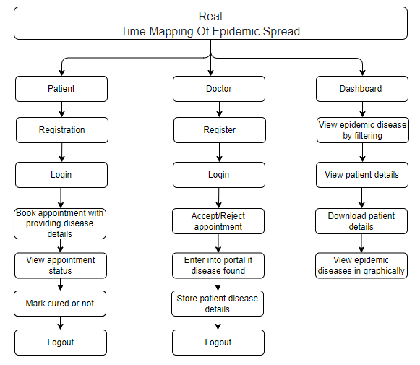
PROJECT FLLOW
Figure: work Flow of Proposed system

Slide 18
HARDWARE & SOFTWARE REQUIREMENTS
SOFTWARE REQUIREMENS
Operating System : Windows 7/8/10
Server side Script : HTML, CSS, Bootstrap & JS
Programming Language : Python
Libraries : Flask, Pandas, Mysql.connector, Os, Smtplib, Numpy
IDE/Workbench : PyCharm

Slide 19
HARDWARE & SOFTWARE REQUIREMENTS
SOFTWARE REQUIREMENS
Technology : Python 3.6+
Server Deployment : Xampp Server
Database : MySQL

Slide 20
HARDWARE & SOFTWARE REQUIREMENTS
HARDWARE REQUIREMENTS
Processor - I3/Intel Processor
RAM - 4GB (min)
Hard Disk - 128 GB
Key Board - Standard Windows Keyboard
Mouse - Two or Three Button Mouse
Monitor - Any

Slide 21
FUNCTIONAL AND NON-FUNCTIONAL REQUIREMENTS
Requirement’s analysis is very critical process that enables the success of a system or software project to be assessed. Requirements are generally split into two types: Functional and non-functional requirements.
Functional Requirements: These are the requirements that the end user specifically demands as basic facilities that the system should offer. All these functionalities need to be necessarily incorporated into the system as a part of the contract. These are represented or stated in the form of input to be given to the system, the operation performed and the output expected. They are basically the requirements stated by the user which one can see directly in the final product, unlike the non-functional requirements.

Slide 22
FUNCTIONAL AND NON-FUNCTIONAL REQUIREMENTS
Examples of functional requirements:
Authentication of user whenever he/she logs into the system
System shutdown in case of a cyber-attack
A verification email is sent to user whenever he/she register for the first time on some software system.
Non-functional requirements: These are basically the quality constraints that the system must satisfy according to the project contract. The priority or extent to which these factors are implemented varies from one project to other. They are also called non-behavioral requirements.

Slide 23
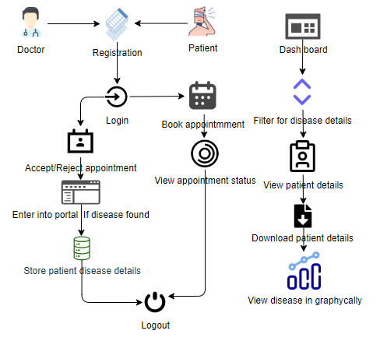
ARCHITECTURE

Slide 24
UML DIAGRAMS
Use Case Diagram:
A use case diagram in the Unified Modeling Language (UML) is a type of behavioral diagram defined by and created from a Use-case analysis. Its purpose is to present a graphical overview of the functionality provided by a system in terms of actors, their goals (represented as use cases), and any dependencies between those use cases. The main purpose of a use case diagram is to show what system functions are performed for which actor. Roles of the actors in the system can be depicted.

Slide 25
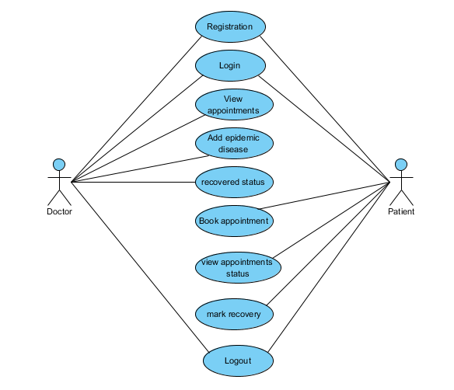
UML DIAGRAMS
Figure: Use Case Diagram

Slide 26
UML DIAGRAMS
Class Diagram:
In software engineering, a class diagram in the Unified Modelling Language (UML) is a type of static structure diagram that describes the structure of a system by showing the system's classes, their attributes, operations (or methods), and the relationships among the classes. It explains which class contains information.

Slide 27
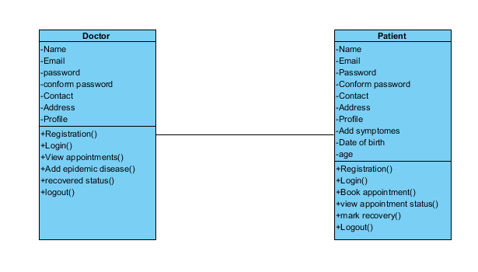
UML DIAGRAMS
Figure: Class diagram

Slide 28
UML DIAGRAMS
Sequence Diagram:
A sequence diagram in Unified Modelling Language (UML) is a kind of interaction diagram that shows how processes operate with one another and in what order. It is a construct of a Message Sequence Chart. Sequence diagrams are sometimes called event diagrams, event scenarios, and timing diagrams.

Slide 29
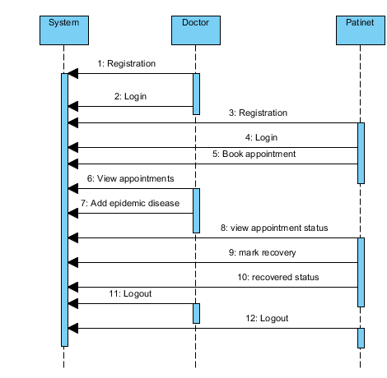
UML DIAGRAMS
Figure: Sequence diagram

Slide 30
UML DIAGRAMS
Collaboration Diagram:
In collaboration diagram the method call sequence is indicated by some numbering technique as shown below. The number indicates how the methods are called one after another. We have taken the same order management system to describe the collaboration diagram. The method calls are similar to that of a sequence diagram. But the difference is that the sequence diagram does not describe the object organization whereas the collaboration diagram shows the object organization.

Slide 31
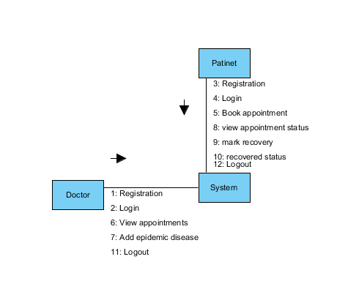
UML DIAGRAMS
Figure: Collaboration diagram

Slide 32
UML DIAGRAMS
Deployment Diagram
Deployment diagram represents the deployment view of a system. It is related to the component diagram. Because the components are deployed using the deployment diagrams. A deployment diagram consists of nodes. Nodes are nothing but physical hardware’s used to deploy the application.

Slide 33
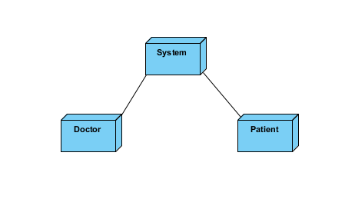
UML DIAGRAMS
Figure: Deployment diagram

Slide 34
UML DIAGRAMS
Activity Diagram:
Activity diagrams are graphical representations of workflows of stepwise activities and actions with support for choice, iteration and concurrency. In the Unified Modelling Language, activity diagrams can be used to describe the business and operational step-by-step workflows of components in a system. An activity diagram shows the overall flow of control.

Slide 35
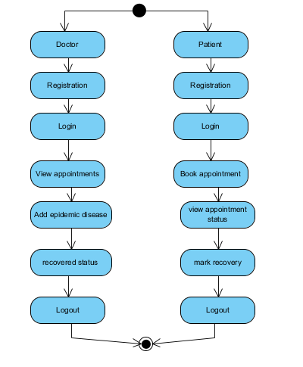
UML DIAGRAMS
Figure: Activity diagram

Slide 36
UML DIAGRAMS
Component Diagram:
A component diagram, also known as a UML component diagram, describes the organization and wiring of the physical components in a system. Component diagrams are often drawn to help model implementation details and double-check that every aspect of the system's required functions is covered by planned development.

Slide 37
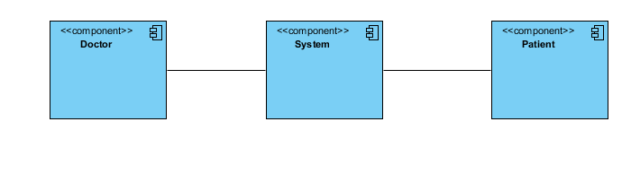
UML DIAGRAMS
Figure: Component diagram

Slide 38
UML DIAGRAMS
ER Diagram:
An Entity–relationship model (ER model) describes the structure of a database with the help of a diagram, which is known as Entity Relationship Diagram (ER Diagram). An ER model is a design or blueprint of a database that can later be implemented as a database. The main components of E-R model are: entity set and relationship set.
An ER diagram shows the relationship among entity sets. An entity set is a group of similar entities and these entities can have attributes. In terms of DBMS, an entity is a table or attribute of a table in database, so by showing relationship among tables and their attributes, ER diagram shows the complete logical structure of a database. Let’s have a look at a simple ER diagram to understand this concept.

Slide 39
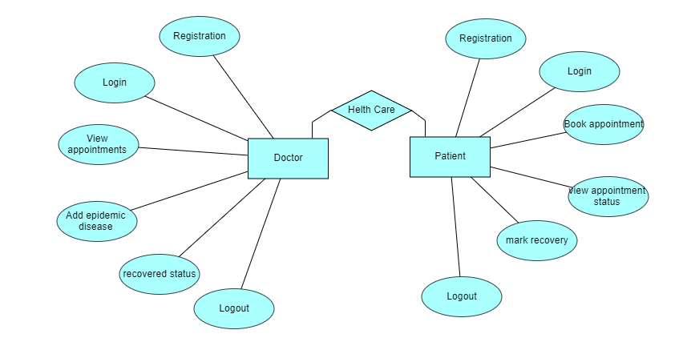
UML DIAGRAMS
Figure: ER diagram

Slide 40
UML DIAGRAMS
DFD Diagram:
A Data Flow Diagram (DFD) is a traditional way to visualize the information flows within a system. A neat and clear DFD can depict a good amount of the system requirements graphically. It can be manual, automated, or a combination of both. It shows how information enters and leaves the system, what changes the information and where information is stored. The purpose of a DFD is to show the scope and boundaries of a system as a whole. It may be used as a communications tool between a systems analyst and any person who plays a part in the system that acts as the starting point for redesigning a system.

Slide 41
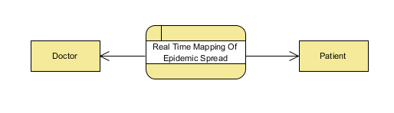
UML DIAGRAMS
Figure: Context Level diagram

Slide 42
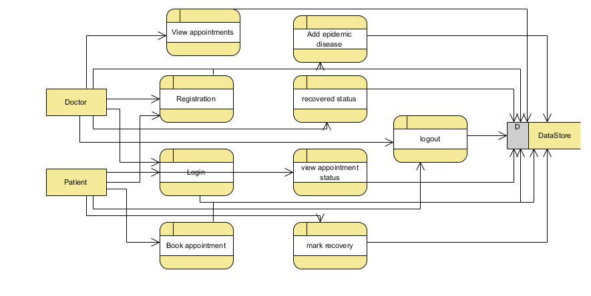
UML DIAGRAMS
FigureLevel-1 diagram

Slide 43
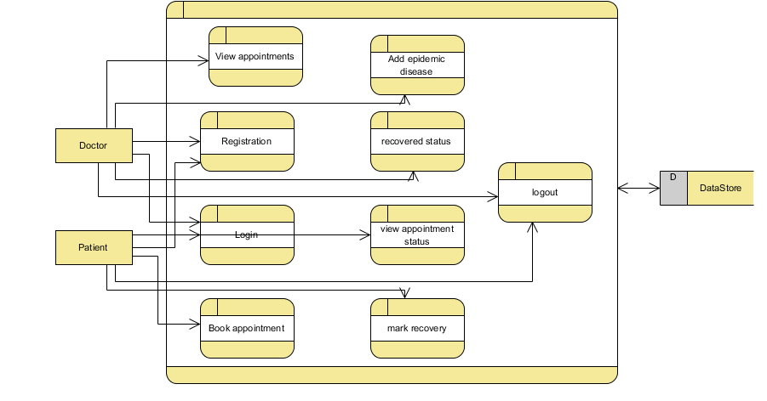
UML DIAGRAMS
Figure:Level-2 diagram

Slide 44
OUTPUT SCREENS
Home page: This is an attendance management home page.

Slide 45
CONCLUSION
In conclusion, the proposed integrated healthcare platform emerges as a transformative solution to the existing challenges in epidemic management. By blending mathematical modeling, machine learning, and practical healthcare functionalities, the system addresses crucial gaps, offering efficient appointment management for doctors and active patient engagement. Despite potential drawbacks such as technological barriers and data security concerns, the platform's overarching goal is to optimize pandemic response, foster a resilient healthcare system, and enhance overall epidemic control and patient care. With its data-driven approach, this platform signifies a significant leap towards a proactive and adaptive healthcare landscape.

Slide 46
FUTURE ENHANCEMENT
The feature scope includes streamlined doctor-patient interactions, real-time epidemic data input, and an intuitive dashboard for comprehensive insights. With efficient appointment management, patients can easily register, track statuses, and update recovery information. The platform employs mathematical modeling and machine learning, empowering doctors for data-driven decision-making. Downloadable patient data and graphical representations enhance informed analysis, contributing to a holistic and proactive approach in epidemic control, optimizing healthcare policies for a resilient system.

Slide 47
REFERENCES
[1] G. Arfken, H.J. Weber, Mathematical Methods for Physicists, 4th edn, Academic Press, San Diego, CA, 1995.
[2] J. Besag, Spatial interaction and the statistical analysis of lattice systems, Journal of the Royal Statistical Society 36 (1974) 192–236.
[3] J. Besag, On a system of two-dimensional recurrence equations, Journal of the Royal Statistical Society 43 (1981) 302–309.
[4] J. Besag, C. Kooperberg, On conditional and intrinsic autoregressions, Biometrika 82 (1995) 733–746.
[5] J. Besag, J.C. York, A. Mollie, Bayesian image restoration, with two applications in spatial statistics (with discussion), Annals of the Institute of Statistical Mathematics 43 (1991) 1–59.
[6] N.G. Best, K. Ickstadt, R.L. Wolpert, D.J. Briggs, Combining models of health and exposure data: The SAVIAH study, in: P Elliott, JC Wakefield, NG Best, DJ Briggs (Eds.), Spatial Epidemiology: Methods and Applications, Oxford, University Press, Oxford, New York, 2000, pp. 393–414.

Slide 48
REFERENCES
[7] D.R. Brillinger, Time Series: Data Analysis and Theory, Holden-Day, San Francisco, 1981.
[8] B.P. Carlin, S. Banerjee, Hierarchical multivariate CAR models for spatio-temporally correlated survival data (with discussion), in: J.M. Bernardo, M.J. Bayarri, J.O. Berger, A.P. Dawid, D. Heckerman, A.F.M. Smith, M. West (Eds.), Bayesian Statistics 7, Oxford University Press, Oxford, 2003, pp. 45–63.
[9] H. Cramer, M.R. Leadbetter, Stationary and Related Stochastic Processes. Sample Function Properties and their Applications, Wiley, New York, 1967.
[10] N. Cressie, Statistics for Spatial Data, Wiley, New York, 1993.
[11] M. Fuentes, H.R. Song, S. Ghosh, D. Holland, J. Davis, Spatial association between speciated fine particles and mortality, Biometrics 62 (2006) 855–863.

